Slide 1
Monetary and Fiscal Policy coordination: game theory perspective
Gulnara Nolan, Matt Nolan and Vladimir Petkov
ER Thursday coffee 12 December
Notes:
Hi everyone, thanks for coming to the coffee today. To start off with I’d like to indicate that this is very early-stage work – we have a framework in mind that we would like to share and discuss, and we’d appreciate feedback about where to take it. The goal of today’s presentation will be to motivate why it is important to think about “how” central banks and governments commit their actions, and how this process of commitment can lead to very different strategic behaviour when faced with varying economic shocks.
It isn’t just the choice of policy instruments and the potential for uncoordinated outcomes that are important for thinking about strategic behaviour. Both central banks and governments might impose costly rules on themselves that are suitable for achieving their individual objectives, but that might have negative consequences overall. Understanding which rules are helpful and which might be harmful can help improve strategic decision making about the way monetary and fiscal policy settings are put in place. Furthermore, by making these strategic behaviours clearer it helps to define clear situations where monetary and fiscal policy should coordinate – as opposed to situations where it is important for independence that monetary authorities act of their own fruition. Furthermore, this presentation highlights the importance of active monetary and fiscal policy rules in macroeconomic models. Understanding whether the central bank should expect fiscal policy to offset or support monetary policy aims, and the quantum of that reaction, matters for improving our forecasting and understanding risks.

Slide 2
Motivation
In Recommendation 3 of the RBA review, the importance of fiscal-monetary coordination was highlighted.
This recommendation justifies further work on how the policies mechanically influence each other – but in this presentation we discuss the tension due to non-cooperative strategic motives.
Fiscal and monetary actions both post-GFC and post-COVID have involved what looks like “pre-commitment” actions by governments and central banks – costly Budget announcements, communication on interest rate paths, quantitative easing, debates about central bank independence.
These motives imply that modelling strategic behaviour matters.
Can game theory be used to understand and model this relationship?
Notes:
The RBA review highlighted the topic of fiscal-monetary coordination as an important area for further work. In order to credibly commit to low and stable inflation, the central bank is delegated independence by fiscal authorities – however, such commitment is important to understand through three key channels:
Emergency response and the timing of interventions.
Forecasting, and the way that fiscal and monetary instruments influence the economic situation faced by the other institution.
Strategic motives that may exist due to the separation of responsibilities between fiscal and monetary agencies.
Today’s presentation is focused on the last of these three channels.
Although there was a rich literature about such motives in the 1980s and 1990s, prior to the GFC such strategic incentives were largely ignored. However, post-GFC and especially post-COVID fiscal and monetary authorities have both taken on increasingly costly actions to “commit” to future choices – including the perception that Phil committed to not raise interest rates until 2024.
However, there is limited literature about how such pre-commitment influences the strategic choices of fiscal and monetary authorities – and we intend to do work on this.
******************************************************************************
Endogenous independence means that the central bank or fiscal authority can set up a costly structure to commit to actions in the future – they could do this by making it costly to change their behaviour, by increasing their future benefit of doing something, by manipulating their own objective function. Ultimately, we can show that agents in a non-cooperative game will have an incentive to select into a “inefficient” rule or impose a cost on changing their announced behaviour, in order to influence the future decisions of the other party they are in a non-cooperative game with.
What is an example. If the central bank was to announce they will hold interest rates at zero until a certain date, it is costly for them to change that – in terms of reputation. If the central bank purchases bonds, there is a monetary cost associated with lifting interest rates that will prevent them from doing so. If the government commits to an annual budget process, their ability to introduce discretionary changes in policy will be restricted and more costly to introduce. All of these common fiscal and monetary policy settings in the current institutional environment look like pre-commitment devices.
For the final bullet – a key point not made in the game theory of monetary policy literature is how different the game is given different economic shocks. A supply shock and a demand shock lead a very different “conflict” between monetary and fiscal authorities.
Modelling
“cooperative” vs “noncooperative” responses to shocks,
Pre-commitment to policy settings through sequential games,
Endogenous independence as costly pre-commitment?
Policy targets, target asymmetry, and outcomes (i.e. can government deal with the inequality consequences of monetary policy).

Slide 3
Motivation
Why does this matter?
Insufficient stimulus post-GFC.
Excessive stimulus post-COVID.
“[I]t is important to recognize that the role of an independent central bank is different in inflationary and deflationary environments. In the face of inflation, which is often associated with excessive monetization of government debt, the virtue of an independent central bank is its ability to say ‘no’ to the government. With protracted deflation, however, excessive money creation is unlikely to be the problem, and a more cooperative stance on the part of the central bank may be called for. Under [these] circumstances, greater cooperation for a time between [central banks] and fiscal authorities is in no way inconsistent with the independence of the central banks, any more than cooperation between two independent nations in pursuit of a common objective is inconsistent with the principle of national sovereignty.”
Ben Bernanke, Chairman of the Board of Governors of the Federal reserve, before the Japan Society of Monetary Economics, Tokyo, Japan, May 31, 2003.
Notes:
So why does pre-commitment and strategic behaviour matter?
Globally, there is a view that there was insufficient stimulus after the GFC, and that there has been excess stimulus after COVID. How did we end up with such different outcomes following two recessions?
When Bernanke talked about the experience of Japan, he noted that the nature of independence and cooperation between fiscal and monetary policy was different in a deflationary environment than in an inflationary one. The key idea here, was that in a deflationary environment the incentives of both institutions push in the same direction – to stimulate – while in an inflationary environment there is a conflict where they offset each other.
However, there is nothing in his description that explains how the interaction between the institutions leads to persistent low or high demand.

Slide 4
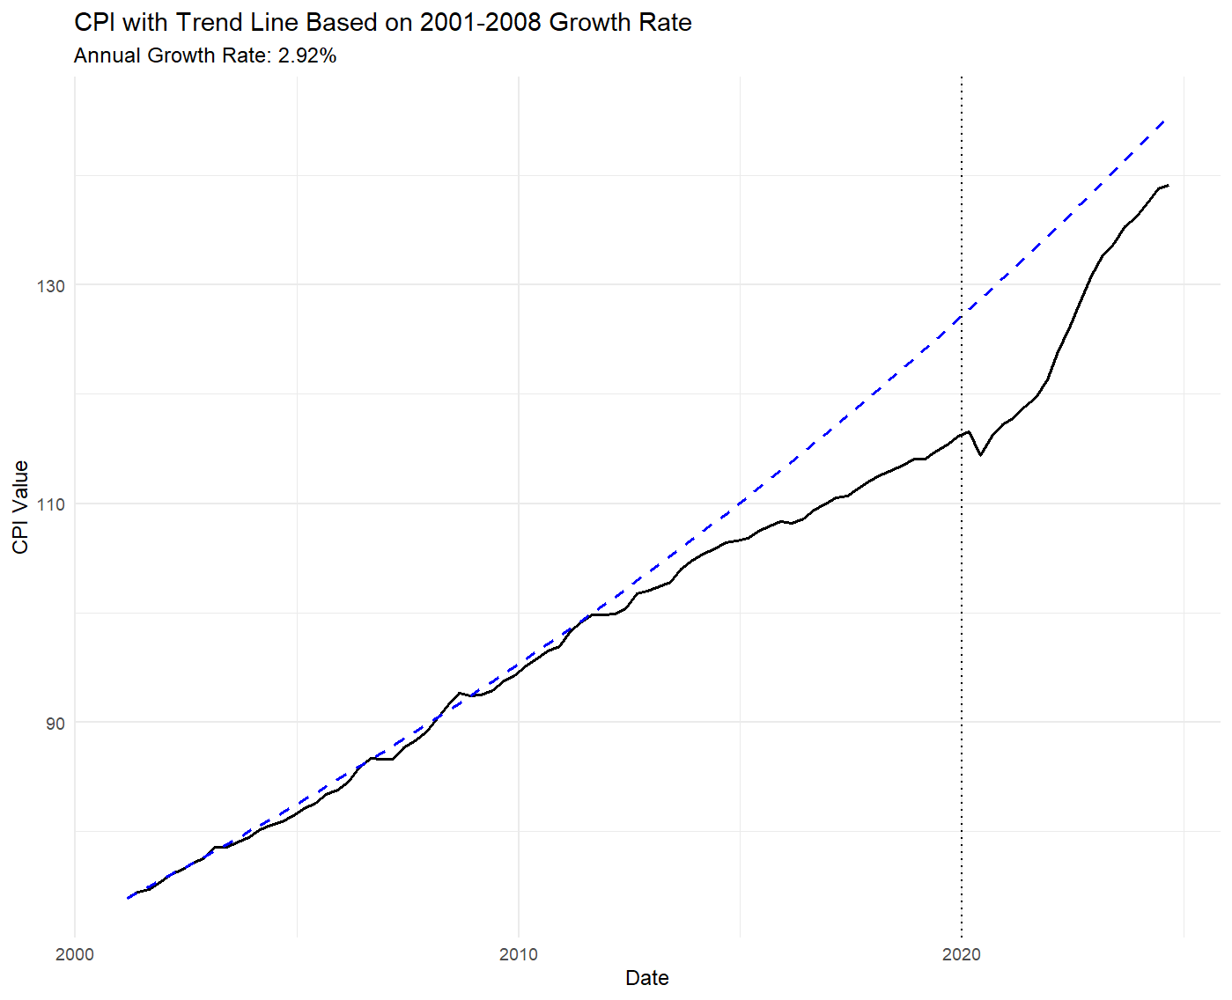
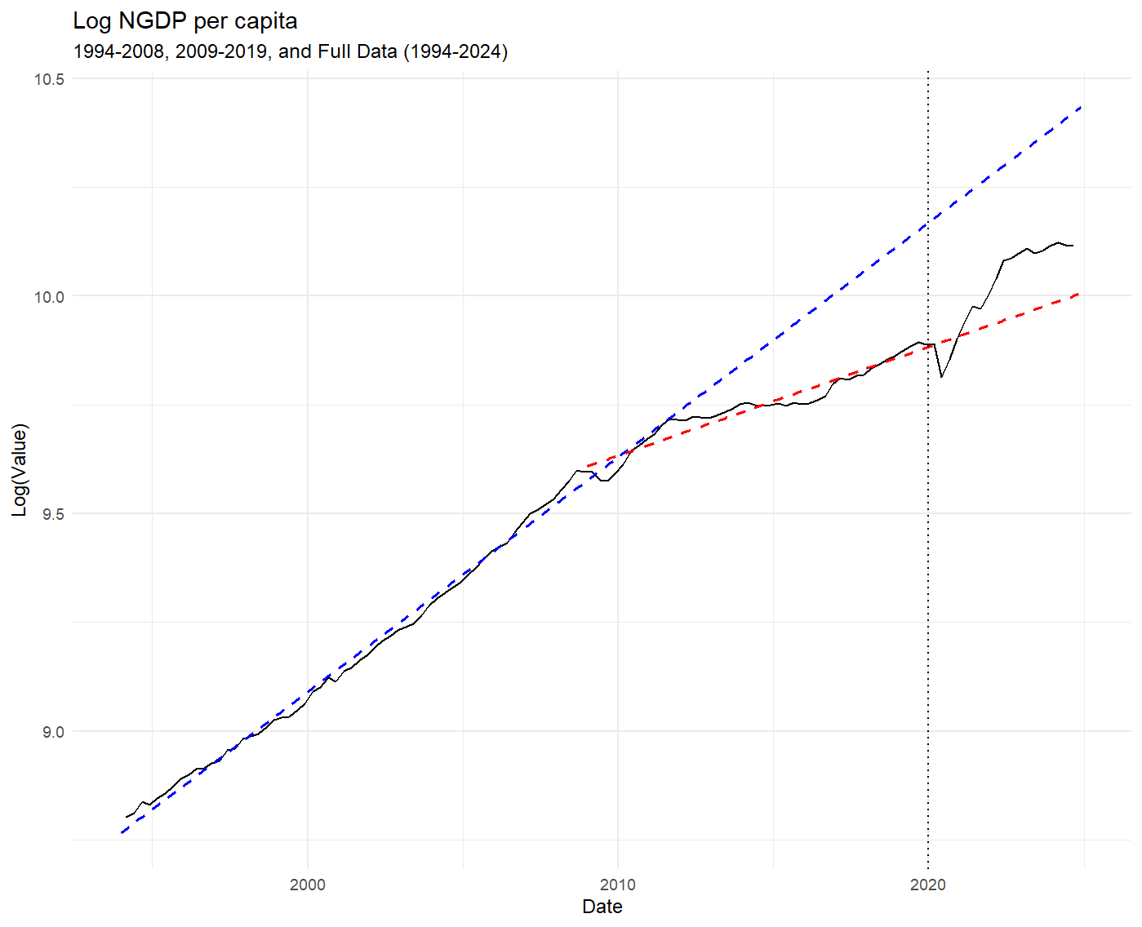
Motivation – post-mining boom
Notes:
So is this relevant for the Australian context?
When we look at the price level and the level of NGDP, we can see that the post-GFC (and especially the post 2012 mining boom period) involved below trend growth in both of these indicators.
Looking after 2020, we can see a persistent rebound in both – and in fact growth in the price level has been persistently above the inflation target.

Slide 5
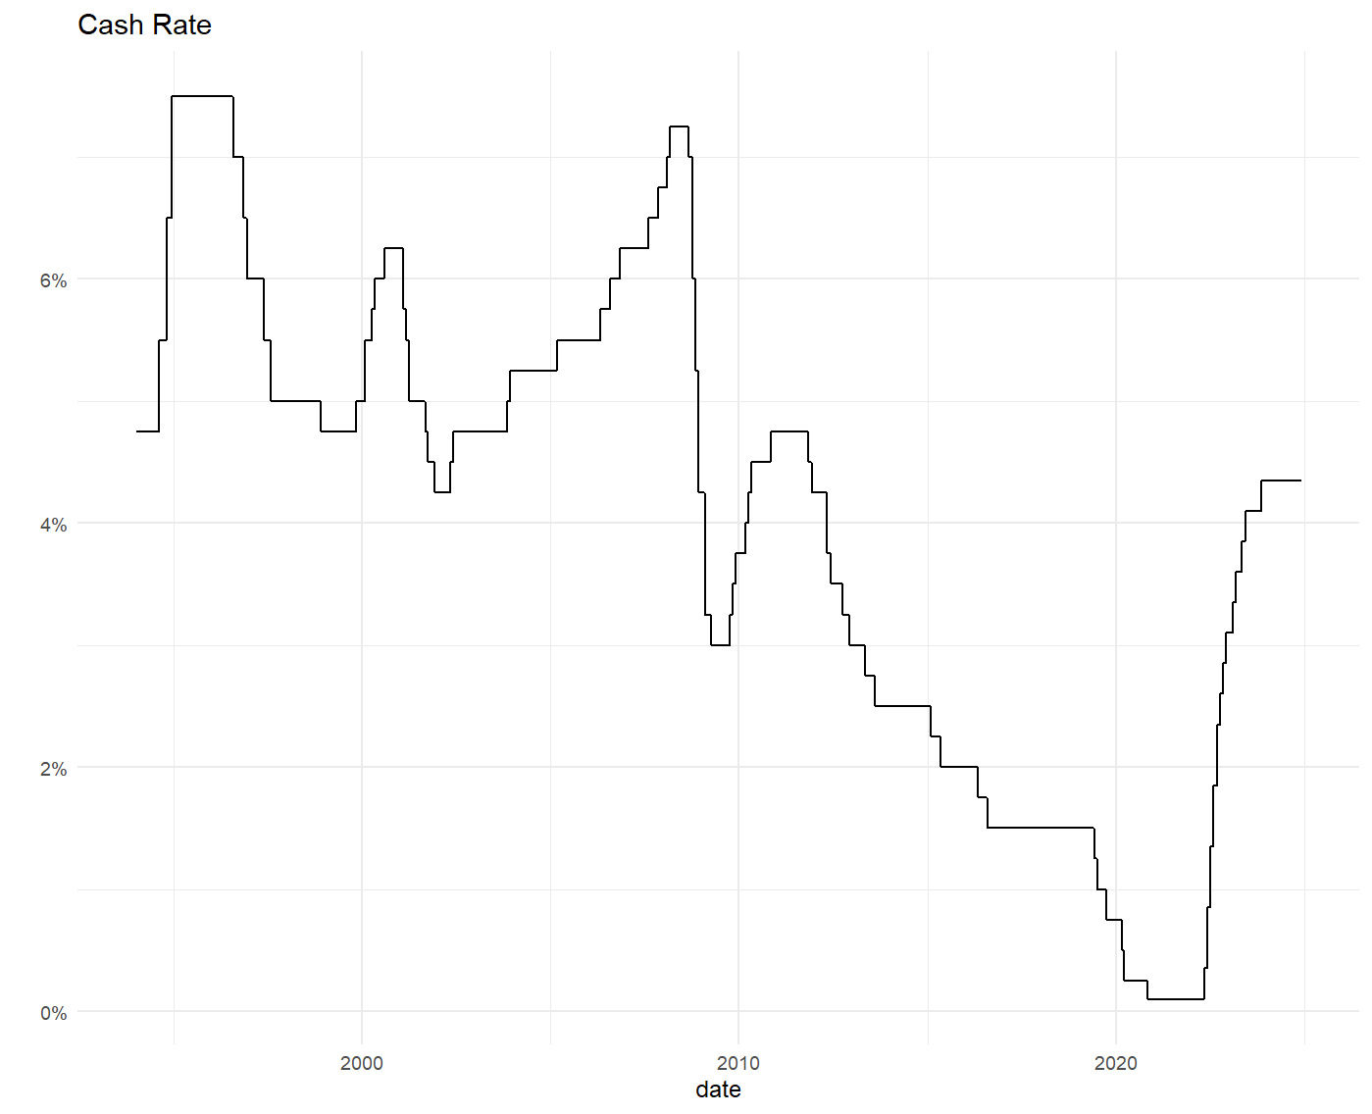
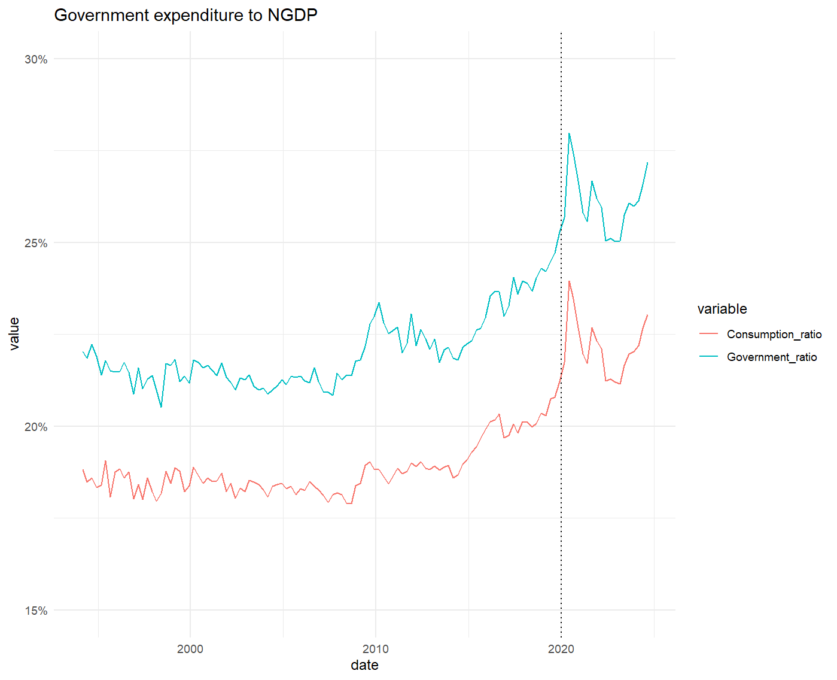
Motivation – post-mining boom
Notes:
Looking at policy choices, we can see that between 2015 and 2021 fiscal and monetary impulses were pushing in the same direction (with the cash rate declining and government spending to GDP rising) – and yet both the price level and NGDP/NGDP growth remained below trend. i.e. both authorities loosened their instrument, but insufficiently to counteract the shock. Post-2021 fiscal and monetary policy have pushed in opposite directions, while prices and NGDP have surged. i.e. both authorities have offset each other when face with a shock.
These were two different shocks (namely a terms of trade led demand shock vs a COVID related supply shock).
Goal is to describe this non-cooperative game and the importance of commitment to instrument paths for determining the relative responses to different shocks.

Slide 6
Motivation
Why does this matter?
Insufficient stimulus post-GFC.
Excessive stimulus post-COVID.
Both scenarios suggest that fiscal and monetary authorities may have been engaged in a non-cooperative game – and the differences in these games give important clues about how to cooperate with different shocks.
Policy stickiness/commitment is key: Has growing policy stickiness (pre-commitment) exacerbated this game? Does the type of shock matter?
Notes:
From the above graphs, arguably Australia has been subject to the same non-cooperative game between policy institutions that has been posited to exist overseas – with insufficient stimulus post-GFC, and offsetting behaviour (and excess stimulus) post-COVID.
We intend to explore the role of policy stickiness in determining these types of outcomes – given that instrument stickiness provides a pre-commitment device. By looking at this we are able to identify whether costly commitment to rules improves or worsens such outcomes, and whether this differs for varying types of economic shocks.

Slide 7
What we do
We outline theoretical relationships between monetary and fiscal policies that may occur in the face of uncoordinated action using concepts from non-cooperative game theory.
We extend the current literature to include
dynamic strategic motives
The ability for policy makers to pre-commit in opposition to each other
The importance of adjustment costs and the choice of stickiness for generating these outcomes
We find that individual rationality by policy makers to independently pre-commit to courses of action may generate worse outcomes for both monetary and fiscal decision makers (depending on the shock)
While we possess an understanding of how these policies affect output and inflation, their effects on inequality remain less clear. Additionally, it is essential to investigate whether the government and the central bank prioritise inequality in their decision-making.
Notes:
To do this we will solve a dynamic strategic game between monetary and fiscal authorities, where there are adjustment costs for changing the policy instrument.
Such a game allows individual institutions to “invest” in leadership, in order to pre-commit their choices and improve outcomes for themselves. In some circumstances this will generate a prisoners dilemma that will make outcomes worse for both monetary and fiscal authorities – in other circumstances, such pre-commitment allows institutions to move closer to the cooperative outcome.
The approach is extremely simplified and will not capture economic dynamics or the benefits of making decision rules time consistent. However, following Dixit and Lambertini (2003) we should be able to add this in the coming months.
The reason why we have simplified the economy to such a great extent is so that we could focus on more complex decision rules for optimal monetary and fiscal policy. We also intend to extend these rules to include other fiscal aims (i.e. inequality), to understand how additional fiscal objectives may influence the best choice for monetary authorities.
******************************************************************************
Introduction:
Monetary policy independence matters for anchoring inflation expectations and mitigating the “time inconsistency” problem that exists between government and the public with regards to monetary policy. However, the crises of the last 20 years have shown that there are limits to this independence – and a blurry line between what constitutes fiscal and monetary policy. Quantitative easing, forward guidance, and fiscal dominance are all active policy areas of research where the relationship between fiscal and monetary policy rules becomes complex. In this piece we hope to inform these debates.
Monetary-fiscal coordination can reflect two separate concerns:
1) Crisis management: The timing, size, and information about announcements may be better organised in the short-term to make sure that responses to a crisis are effective and measured.
2) Objective relationships: The fiscal and monetary policy rules may interact in unintended ways relative to a welfare maximising dynamic path, in ways that may be difficult to tease out. These may situations where policies offset, or where they support each other.
We believe that non-cooperative game theory – specifically a dynamic game with policy adjustment costs – can provide novel insights into this second form of monetary-fiscal coordination, the nature of fiscal and monetary policy rules, and potential pitfalls of strict monetary or fiscal leadership/independence.
########################
It is common to look at fiscal and monetary policy decision making separately when analysing optimal policy – with the Kyland Prescott (1977) motivation for independence due to time inconsistency being used as a justification for an independent central bank, which weighs inflation more heavily than a “social planner” would. Since the Global Financial Crisis, it has become clearer that monetary and fiscal authorities' roles can be intertwined, and that there are benefits from coordination. Furthermore, forward guidance and debate about fiscal dominance and monetary policy offset have become major areas of investigation. There are two ways that coordination/cooperation matter: 1) Crisis management: The timing, size, and information about announcements may be better organised in the short-term to make sure that responses to a crisis are effective and measured.
2) Objective relationships: The fiscal and monetary policy rules may interact in unintended ways relative to a welfare maximising dynamic path, in ways that may be difficult to tease out. These may situations where policies offset, or where they support each other.
We believe that non-cooperative game theory – specifically a dynamic game with policy adjustment costs – can provide novel insights into this second form of monetary-fiscal coordination, the nature of fiscal and monetary policy rules, and potential pitfalls of strict monetary or fiscal leadership/independence. #################################### Few comments:
What is the role of expectations in the game? Do/ can we incorporate it?
Why do we need to generalise the model?
What is the question we are trying to answer?
Based or on top of what has already been done, what explicitly are we proposing?

Slide 8
Results
We will provide a dynamic strategic game of monetary and fiscal policy setting, allowing for “strategic pre-commitment”.
To our knowledge, the first dynamic strategic game of monetary and fiscal policy shocks.
Linking past policy to the current state generates a dynamic strategic component to monetary-fiscal coordination that is understudied.
Provides a fuller understanding of “commitment” and leadership.
A first approach that recognises the different game played given different shocks (supply and demand shocks differ in the substitutability and complementarity of choices).
Will also dynamically model the “choice” of commitment regime by fiscal and monetary authorities
Highlights a possible policy failure if both fiscal and monetary authorities compete over commitment.
Today’s model is a simple linear-quadratic framework to highlight what we intend to model more fully over the coming months.
Notes:
To sum up, our main contributions are:
A dynamic game theory model that allows for pre-commitment.
A discussion of how monetary fiscal conflict varies on the basis of supply vs demand shocks.
Endogenous determination of commitment regimes and their relation to social welfare.

Slide 9
Modelling approach

Slide 10
Key pieces
Monetary authorities are given an asymmetric inflation target in order to prevent time inconsistency (Kyland and Prescott, 1977).
This generates a non-cooperative game between authorities (Debelle and Fischer, 1994 and Dixit and Lambertini, 2003) – an inferior Nash Equilibrium that can be mollified through monetary leadership.
Sargent and Wallace (1981), Cochrane (2021), Betheley etal (2024) – fiscal authorities can use debt to influence monetary policy, even after delegation of authority (fiscal dominance/leadership).
However, there has not been general modelling of what generates leadership. We combine three pieces of literature to describe this:
Woodford (1999) – interest rate smoothing an adjustment costs of changing instruments.
Dixit (1997) – dynamic investment models.
Dixit and Lambertini (2003) – reduced form modelling of simple LQ loss functions to define decision rules for monetary and fiscal policy.
Notes:
Dynamic strategic behaviour has long been a central part of monetary economics – with the time inconsistency result of Kyland and Prescott an early version of that.
A series of papers have focused on monetary and fiscal leadership in terms of the determination of outcomes. (e.g. Debelle and Fischer, Dixit and lambertini). These approaches have highlighted that non-cooperative behaviour can generate both insufficient and excessive stimulus, depending on certain state variables (i.e. the degree of monopolistic competition, the level of government debt).
However, leadership in such models is often given by assumption – rather than being the result of an endogenous choice by an agent to undertake a costly investment to claim leadership.
What we will discuss today takes pieces from three strands of the literature. The base approach follows Dixit and Lambertini – although it is currently much more simplified – in terms of modelling the dual choice of monetary and fiscal authorities. We then follow Woodford (1999) in including an adjustment cost for changing the policy instrument – an assumption that is central to drive the type of behaviour we will describe. Given this structure, we can then apply the dynamic investment approach of Dixit to the choice of monetary and fiscal policy in order to solve this game. ************************************************************************************************* To sum up, our main contributions are:
A dynamic game theory model that allows for pre-commitment.
A discussion of how monetary fiscal conflict varies on the basis of supply vs demand shocks.
Endogenous determination of commitment regimes and their relation to social welfare.
There are a series of other games:
Debelle and Fischer, 1994 and Dixit and Lambertini, 2003: Non-cooperative game with asymmetric objective function leads to a Nash Equilibrium absent shocks in a standard New Keynesian setting.
Dixit and Lambertini, 2003: Lack of fiscal coordination within a currency zone, prisoners dilemma.
Cochrane: Fiscal dominance – government pre-commitment to higher debt path, forcing a situation where monetary authorities lose independence as they are unable to commit to sufficiently high interest rates to push inflation back to target (i.e. the government is forced to use non-interest bearing measures, such as inflation, to reduce debt burdens). Major topic for ECB: https://www.ecb.europa.eu/press/key/date/2024/html/ecb.sp240607~c6ae070dc0.en.html
Betheley 2024: Debt chicken game – strategic modelling of fiscal dominance (https://www.gplantin.net/ARFE_10_15_final_WP.pdf)
However, in industrial economics the concept of leadership evolved through the 1980s. Essentially, leadership in a game of strategic substitutes could be gained by imposing a cost that influenced your future actions. These costs are similar to the commitment devices and smoothing rules that are often justified by central banks:
XXX
XXX

Slide 11
Key pieces
Adjustment costs of changing policy instruments.
XXX
XXX
Dynamic investment models and supermodularity.
XXX
Notes:
To sum up, our main contributions are:
A dynamic game theory model that allows for pre-commitment.
A discussion of how monetary fiscal conflict varies on the basis of supply vs demand shocks.
Endogenous determination of commitment regimes and their relation to social welfare.

Slide 12
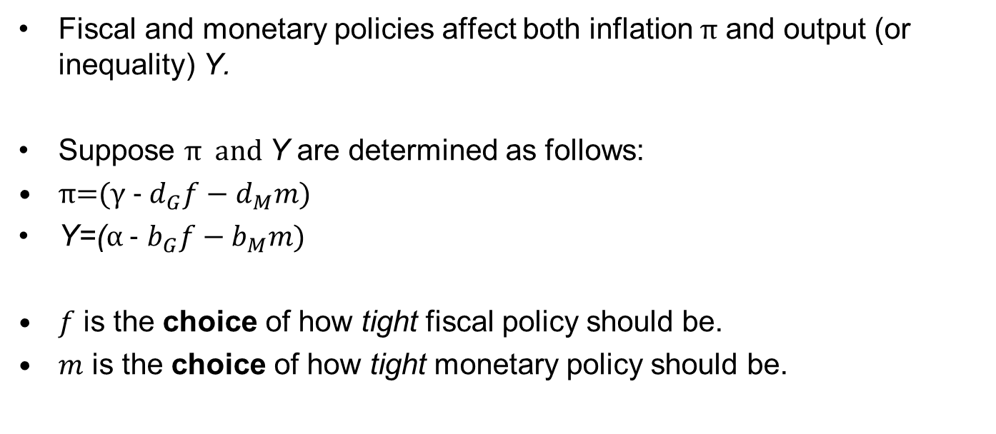
Simple Static Model
Fiscal and monetary policies affect both inflation π and output (or inequality) Y.
Suppose π and Y are determined as follows:
π=(γ - $d_{G}f−d_{M}m)$
Y=(α - $b_{G}f−b_{M}m)$
$f$ is the choice of how tight fiscal policy should be.
$m$ is the choice of how tight monetary policy should be.
Notes:
For this exercise we start with a simple approach where fiscal and monetary authorities choose the tightness of their own policy settings – and this tightness reduces both output and inflation. This tightness for fiscal policy is termed f while the tightness for monetary policy is terms m.
These can be considered as reduced form approximations of the Phillips Curve and IS equations respectively, as discussed for a similar game in Dixit and Lambertini (2003). Here if both policy instruments were set to neutral – or zero – output would be determined by alpha and inflation would be determined by gamma. As fiscal policy tightness rises inflation declines by d_G and output declines by b_G per unit of tightness, with a similar form for response to tightness in monetary policy. The relationship is linear and other agents choices do not directly influence the effectiveness of the other players instrument.
In this case, we have a simple approach that allows inflation and output to be codetermined by fiscal and monetary policy settings. As a result, if one agent values either inflation or output it is the choice of both players that will determine their payoff.

Slide 13
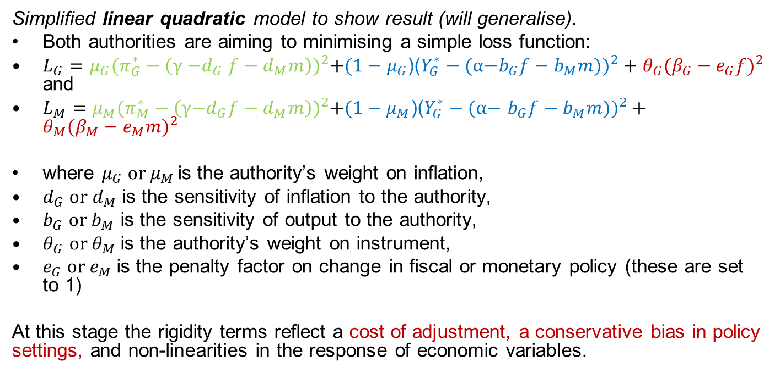
Model (static game)
Simplified linear quadratic model to show result (will generalise).
Both authorities are aiming to minimising a simple loss function:
$L_{G}=μ_{G}{(π_{G}^{∗}−\left(\text{γ}{\text{−}d}_{G}f−d_{M}m\right))}^{2}+(1−μ_{G}$)(${Y_{G}^{∗}−(\text{α}\text{−}b_{G}f−b_{M}m))}^{2}+θ_{G}({β_{G}−e_{G}f)}^{2}$ and
$L_{M}=μ_{M}{(π_{M}^{∗}−\left(\text{γ}\text{−}d_{G}f−d_{M}m\right))}^{2}+(1−μ_{M}$)(${Y_{G}^{∗}−(\text{α}\text{−} b_{G}f−b_{M}m))}^{2}+θ_{M}({β_{M}−e_{M}m)}^{2}$
where $μ_{G} or μ_{M }$is the authority’s weight on inflation,
$d_{G} or{ d}_{M}$ is the sensitivity of inflation to the authority,
$b_{G}$ or $b_{M}$ is the sensitivity of output to the authority,
$θ_{G}$ or $θ_{M}$ is the authority’s weight on instrument,
$e_{G}$ or $e_{M}$ is the penalty factor on change in fiscal or monetary policy (these are set to 1)
At this stage the rigidity terms reflect a cost of adjustment, a conservative bias in policy settings, and non-linearities in the response of economic variables.
Notes:
The payoffs for fiscal and monetary authorities can then be determined with respect to a loss function for both players. As the determination of inflation and output are both linear, this becomes a linear-quadratic loss function. Such an approach is common in the literature and is implemented to make the problem more tractable.
Look at the fiscal authorities loss function to start with there are three quadratic terms that make up the total loss – the loss from deviations from “target” inflation in green, the loss from deviations from “target” output in blue, and the loss from moving from a target level of the instrument in red.
Although the slide talks through the relative meaning of the set of parameters it is useful to give an example. In everything we do the “e” term will be one, and the beta terms will also be zero. As a result, the instrument smoothing penalty refers to a cost associated with changing the instrument from a neutral level. As it is a static model this may reflect a cost of adjusting policy from its prior level or a cost of moving away from a “balanced budget” or “normal interest rate” – these two factors cannot be separated until we allow for dynamics.
The mu term represents the relative weight placed on inflation for this player. We will assume that mu is zero for government and 1 for the central bank in the simulations below, but similar results hold as long as mu_G is smaller than mu_M. As central bank independence has been put in place specifically to delegate authority and responsibility for inflation to the central bank this is a reasonable assumption.
When mu_G = 0 the loss in the absence of transaction costs is driven by the term in blue. This reflects how current output differs from the output target – with a symmetric loss associated with the same absolute deviation above and below this level. If alpha is below Y_g star and m was zero, this tells us that there will be an incentive for the government to loosen policy to push output up to its target level – however, the cost of changing the instrument will mollify this response, and so will see authorities not fully close this gap.
The purpose of this game will be to understand how this set of incentives plays out strategically – and as a result how the existence of costs associated with changing policy can lead to very different outcomes depending on the institutional structure at play.
***************************************************************
Note: The social welfare function may be different again from these loss functions. DL (2003) estimate a social welfare function when talking through their results, while Coury and Petkov (2010) have the fiscal authorities objective as the social welfare function, and are trying to deal with concerns about time commitment and the role of delegation.
The idea is as follows. The social planner wants to maximise social welfare. However, it sets things up such that each authority – fiscal or monetary – only chooses a single objective and is responsible for it with its single target. In this case, we will set Mg to 0 and Mm to 1 so that government only thinks about output and the monetary authority only thinks about inflation.
In this case, we may have a social planner that values both output deviations and inflation deviations equally, and they have split these responsibilities because they expect the authorities to achieve this end. In fact, if the two “cooperate” they will behave in this way.
The only complication is how we view the “adjustment” cost. If that is part of social welfare then we can view the cooperative outcome as equivalent to the welfare maximizing outcome. If instead it is a psychic cost on the institution alone, and not part of social welfare, these will be different.

Slide 14
Demand shock

Slide 15
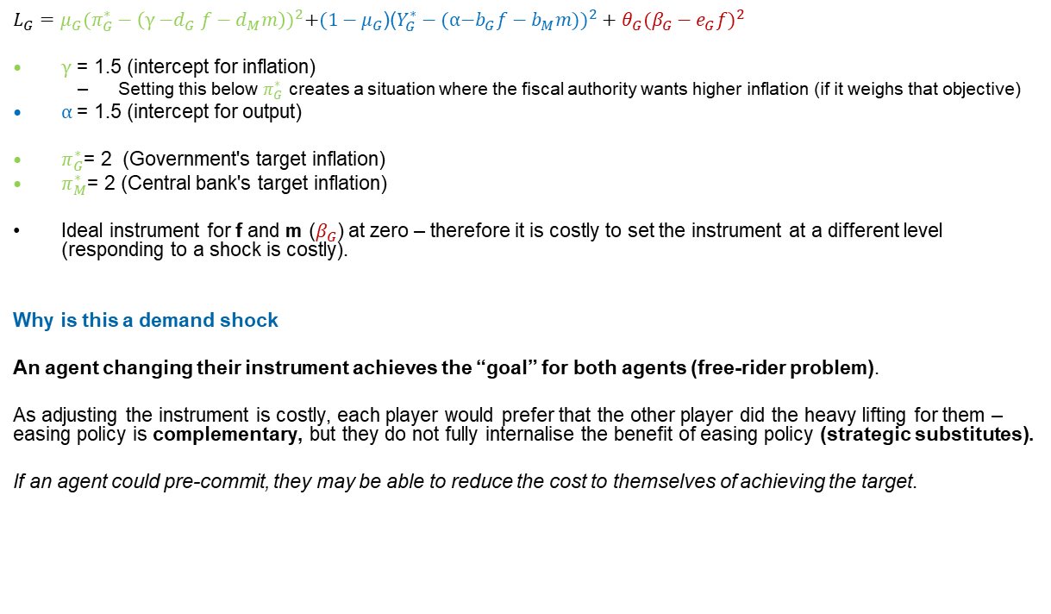
Static Demand shock
$L_{G}=μ_{G}{(π_{G}^{∗}−\left(\text{γ}{\text{−}d}_{G}f−d_{M}m\right))}^{2}+(1−μ_{G}$)(${Y_{G}^{∗}−(\text{α}\text{−}b_{G}f−b_{M}m))}^{2}+θ_{G}({β_{G}−e_{G}f)}^{2}$
$\text{γ}$ = 1.5 (intercept for inflation)
Setting this below $π_{G}^{∗}$ creates a situation where the fiscal authority wants higher inflation (if it weighs that objective)
$\text{α}$= 1.5 (intercept for output)
$π_{G}^{∗}$= 2 (Government's target inflation)
$π_{M}^{∗}$= 2 (Central bank's target inflation)
Ideal instrument for f and m ($β_{G}$) at zero – therefore it is costly to set the instrument at a different level (responding to a shock is costly).
Why is this a demand shock
An agent changing their instrument achieves the “goal” for both agents (free-rider problem).
As adjusting the instrument is costly, each player would prefer that the other player did the heavy lifting for them – easing policy is complementary, but they do not fully internalise the benefit of easing policy (strategic substitutes).
If an agent could pre-commit, they may be able to reduce the cost to themselves of achieving the target.
Notes:
Before explaining why this is a shock it is useful to define what “neutral” is in this simplified approach. As discussed on the previous slide, the incentive to adjust policy comes from the difference between the inflation and output targets, and the realised level of inflation and output.
If both targets are equal to 2, and if alpha and gamma are equal to 2, then the loss can be set to zero when both fiscal and monetary authorities set their instrument to zero. At a choice of zero there is no adjustment cost, and the decision to change from zero would BOTH increase the loss relative to inflation and output as well as generating an adjustment cost.
However, if gamma and alpha both fell to 1.5 we would have a situation where – with instrument choices at zero – current inflation and output would be below their target level. Here both fiscal and monetary authorities have an incentive to increase demand by reducing their instrument, but when they do so they take on an adjustment cost for changing their instrument.
Given this, they will balance the cost of changing their instrument with the benefit of reducing the deviation of inflation and output from their target level. The wrinkle is the spillover between players actions.
If the fiscal authority stimulates, this will reduce the gap between output and their target level of output and it will come with the cost of adjusting their instrument. However, it also has a spillover benefit on the monetary authority that is not internalised. As this spillover is not internalised, fiscal authorities will tend to “under stimulate” – the marginal private value of stimulus is lower than the marginal social value. In a situation where both players act in a selfish manner, they will not take into account the benefit of their actions on the other player, and they will end up under-stimulating.
Furthermore, if a player can pre-commit they will aim to push the cost of stimulus off of themselves and onto the other player – we would expect pre-commitment to lead to WORSE outcomes and the player aims to free-ride on the efforts of the second player.

Slide 16
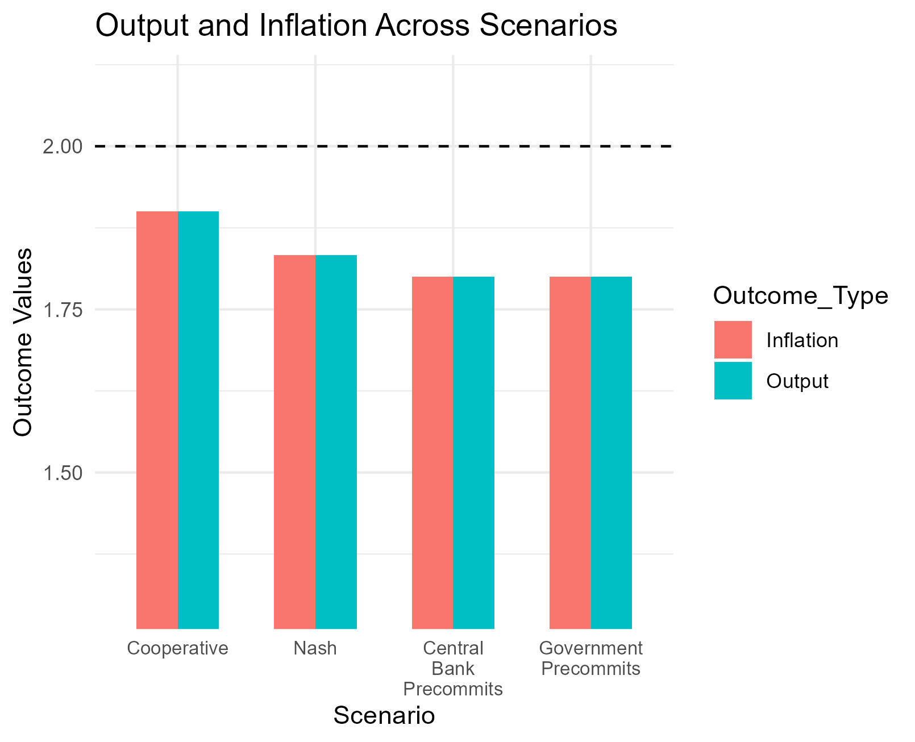
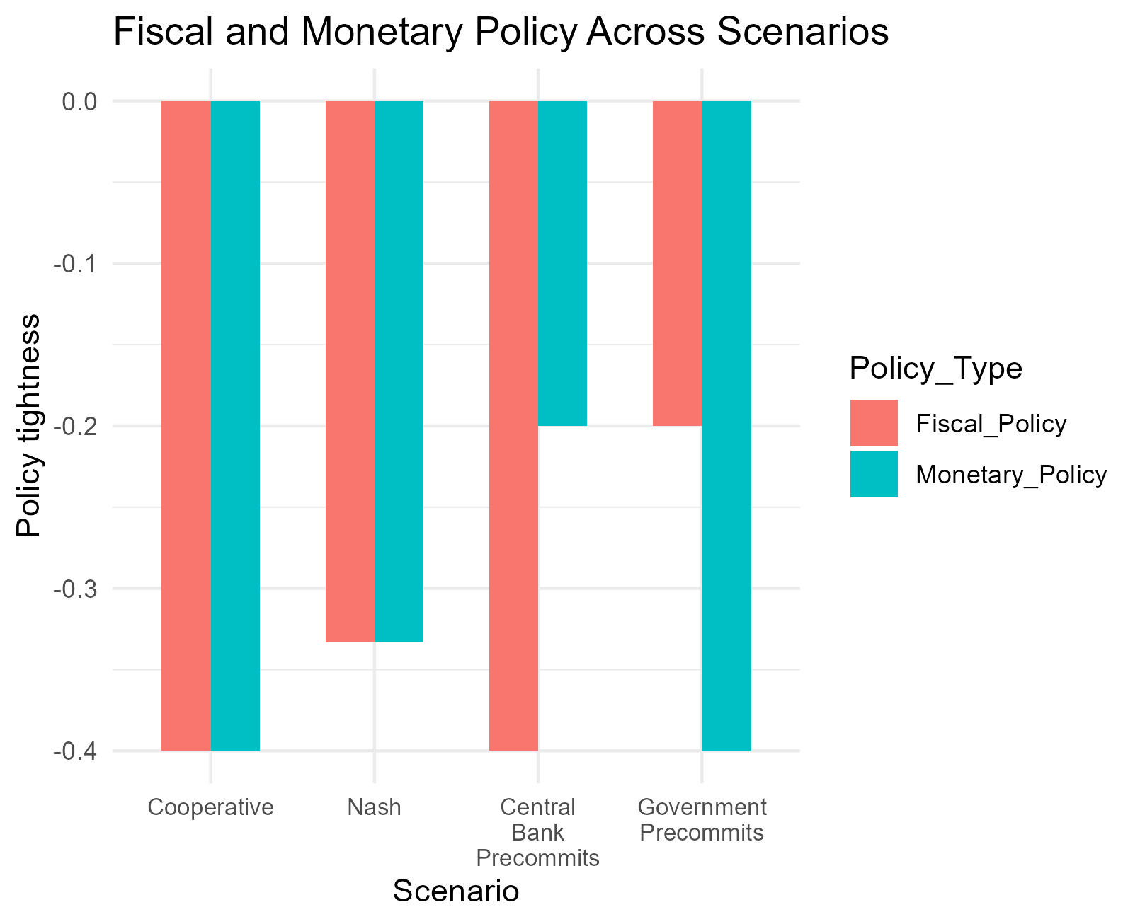
Choices (demand)
Notes:
These are the static equilibrium results for four games.
The game on the left is the cooperative outcome – where the two instruments are chosen cooperatively in order to minimize the overall loss. This leads to the highest level of output and inflation, but due to the cost of adjustment it does not rise all the way to its initial value of 2/2.
The second game is the static Nash Equilibrium. This is when the players act independently, but they do not have information about the choice the other player will make. In this instance inflation and output are lower as both players stimulate less.
The next two are precommitment games – or what are known as Stackelberg leader games. Surprisingly, when a given institution pre-commits they reduce their policy by EVEN LESS. As actions are strategic substitutes, the pre-committing player knows that by doing less they can force the other player to do more when they move – and as a result they shift the cost of adjustment away from themselves and onto the next player. This leads to even lower levels of inflation and output.
*********************************************************************************
Demand shock:
NE leads to less easing by both authorities after a demand shock.
“Pre-commitment” or “leadership” generates worse outcomes – unlike the other literature (i.e. Debelle and Fischer 1994). Why? Cost of policy adjustment generates a free-rider problem which gets worse with pre-commitment.
The idea here is that equilibrium play leads to “conservative” play by both fiscal and monetary authorities.
As it common to describe monetary policy as a “follower” where the fiscal impulse has been previously set by government, these incentives lead to the worst of all outcomes. Leads to excessive fiscal tightness during a demand shock.

Slide 17
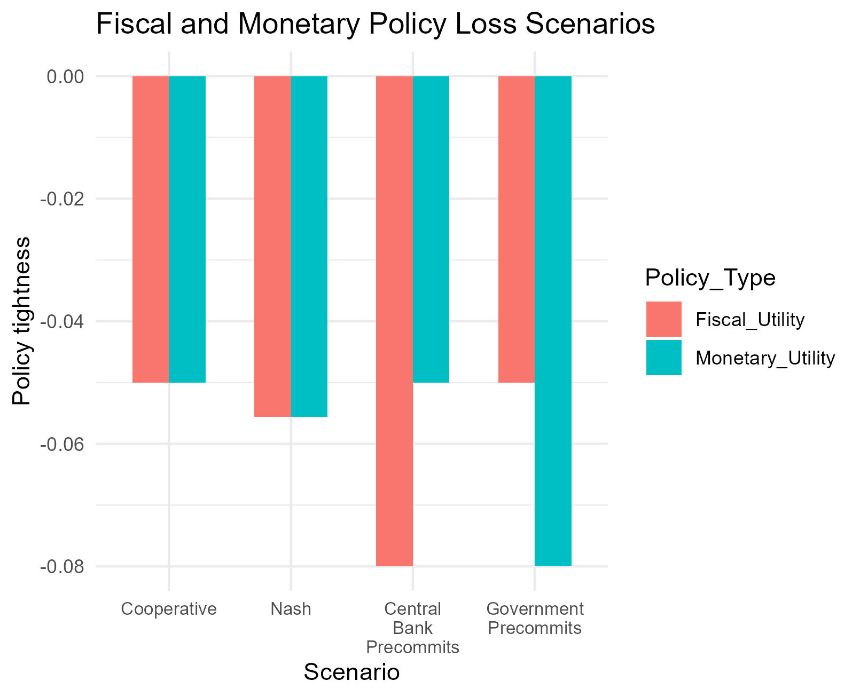
Payoffs (demand)
XXXX
Notes:
When we look at the losses faced in these games, the Nash Equilibrium is clearly a prisoners dilemma – the players acting in their own self-interest end up worse off than if they cooperated.
However, the pre-commitment games end up with larger overall losses – as the pre-committing player is able to reduce the cost on themselves, by imposing a much larger cost on the other organization.
Does this result hold up when we then look at a dynamic version of this game.

Slide 18
Dynamic game
Previously looked at a static model.
“Leadership” was just given. But leadership can be defined endogenously by adding a link between current choices and future payoffs.
The idea of “costly change in a policy instrument” – and therefore the idea of “precommitment” – require dynamics.
For this we will write a dynamic Stackelberg model of monetary policy.
Stages of this approach
Initial Dynamic game (today): To show the value of the intertemporal link.
Dynamic choice game with shocks: Infinite horizon model, with differing expectations about the nature of future “shocks” (i.e. demand or supply shocks).
Endogenising “pre-commitment”: If monetary and fiscal authorities can undertake constrain themselves (independence) does this worsen outcomes.
Macro-model and incorporating time inconsistency: Allows us to describe “optimal independence” of monetary and fiscal policy.
Notes:
A Stackelberg leadership game does not mean that one player moves first. It means that the other player KNOWS what that players choice will be. A similar result can be found if there is an infinite cost for the player from changing from the choice the other player anticipates. As a result, similar to the firm investment game of Dixit (1997), we can generate a leadership game when there are repeated simultaneous choices by agents by using an explicit adjustment cost for changing the level of stimulus – in the model below we denote this specific cost with the parameter lambda. If there is an “adjustment cost” then a decision maker will be unwilling to adjust their behaviour if the benefit of moving to the true “optimum” is less than the cost of moving (i.e. menu cost models of price adjustments to inflation). As a result, by setting such a cost an individual is able to credibly commit to a different course of action than the static nash equilibrium.
Today we will be showing the high-level dynamic game with permanent shocks to demand and supply. Our intention is to extend this game to include stochastic shocks that dampen through time, to allow endogenous choices about the degree of precommitment, and to incorporate this into a more realistic macro-model that includes a countervailing benefit of commitment – namely public expectations and concerns about time inconsistency.

Slide 19



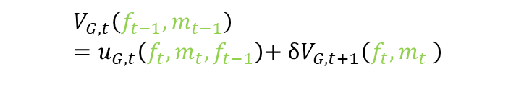
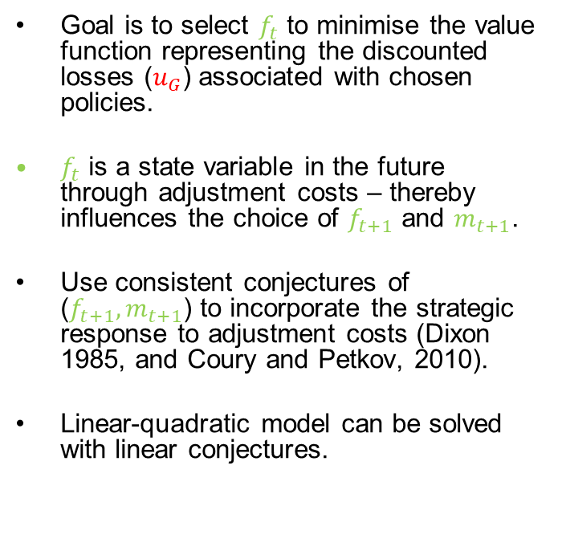
Initial dynamic game
Bellman equation for fiscal authority
Goal is to select $f_{t}$ to minimise the value function representing the discounted losses ($u_{G}$) associated with chosen policies.
$f_{t}$ is a state variable in the future through adjustment costs – thereby influences the choice of $f_{t+1}$ and $m_{t+1}$.
Use consistent conjectures of ($f_{t+1},m_{t+1}$) to incorporate the strategic response to adjustment costs (Dixon 1985, and Coury and Petkov, 2010).
Linear-quadratic model can be solved with linear conjectures.
$$V_{G,t}\left(f_{t−1},m_{t−1}\right)=u_{G,t}\left(f_{t},m_{t},f_{t−1}\right)\text{+ }δV_{G,t+1}\left(f_{t},m_{t} \right)$$
Euler equation for fiscal authority
Notes:
Our dynamic game takes the static loss function from earlier, and assumes that we have an infinitely repeated simultaneous move game between fiscal and monetary authorities. The loss at each period for the fiscal authority is now denoted as u_g_t, and will depend on the choice of fiscal and monetary policy settings. However, due to adjustment costs it is also a function of the prior choice of fiscal settings.
We can write the Bellman function for this game in terms of these choices and the relevant state variables – where the state variables (ft-1 and mt-1) are simple the prior choices of fiscal and monetary policy. No economic variables are state variables in this case, as output and inflation are not a function of past output and inflation in our approach. This simplifies the simulations, and allows us to focus on the strategic policy rules.
The choice of f and m at time t can then be written as policy rules, which are a function of the state variables. We apply consistent conjectures (or the method of undetermined coefficients) to solve for the parameters of these rules, where we can conjecture that the rules will be linear in the state variables, due to the linear quadratic structure of the game we initially defined. The logic behind consistent conjectures is that we want to find a set of beliefs that a player will hold about the other players choice, that will be correct in equilibrium.
The Euler equation we use to solve for this is shown at the bottom left of the slide. The numbered subscripts on these equations reflect partial derivatives with respect to the argument in brackets – for example the first term is the partial derivative of the loss function for government with respect to the current choice of f.
******************************************************************************************************************************
Consistent conjectures are when a player makes a conjecture about the form of the response of the other player to their action – we then iterate the model to make sure those conjectures are “consistent” with rational choice.
Can read the three terms of the Euler equation as: 1) The static optimization term (FOC, marginal loss set to zero in static game).
2) The optimal response of the fiscal authority through the optimal choice of f and m in the following period.
3) The optimal readjustment of f to the strategic response of m.

Slide 20
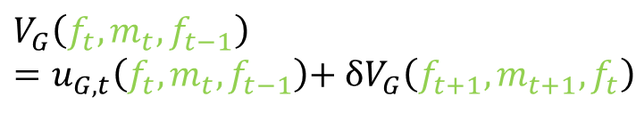
Logic of adjustment costs
Bellman equation for fiscal authority
Why would you impose an adjustment cost on yourself?
Menu cost logic – a small cost can prevent an individual from moving to their optimum point.
Pre-commitment – by imposing this cost on their future selves, a policy maker can commit to a known point that differs from their static Nash Equilibrium.
$$V_{G}\left(f_{t},m_{t},f_{t−1}\right)=u_{G,t}\left(f_{t},m_{t},f_{t−1}\right)\text{+ }δV_{G}\left(f_{t+1},m_{t+1},f_{t}\right)$$
Euler equation for fiscal authority
Notes:
Given this framework, why would an individual want to impose an adjustment cost on themselves?
If the adjustment cost is OBSERVED by the other player, then when they form their beliefs, they’ll realise that policy settings that differ from the static Nash Equilibrium, might be sustainable choices due to the cost of adjusting to that static value – as a result, a player with adjustment costs can credibly commit to a different action than the static Nash Equilibrium.
We know from the static game that players have an incentive to LEAD, as that allows them to lower costs on themselves. In the same way, by imposing a cost on themselves they can put themselves in a leadership position and reduce these costs.

Slide 21
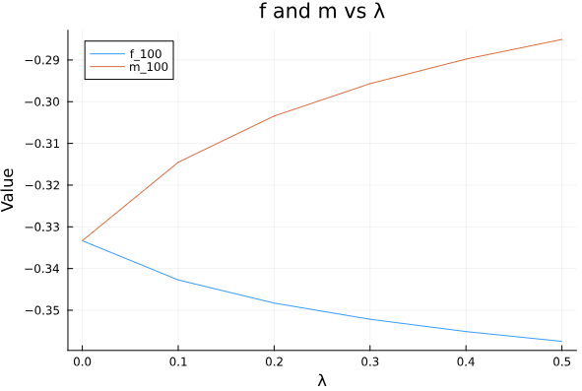
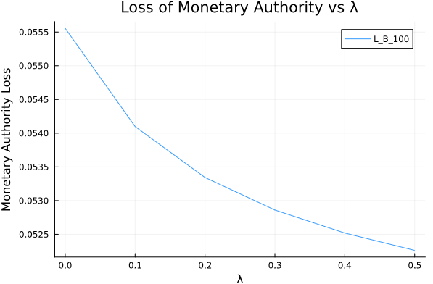
Dynamic game: Incentive for leadership
If it was costless to adjust fiscal policy
As adjustment cost of m rises, m falls.
But also f rises.
Adjustment cost used to commit to “doing less”
The “loss” to the monetary authority declines as the adjustment cost rises – incentive to make instrument too sticky (conservative bias).
Notes:
This is the simulation from a game where there is no adjustment cost for fiscal authorities (although there remains a penalty from neutral), but there is an adjustment cost for the monetary authority.
When the monetary authority does not have an adjustment cost the equilibrium is the same as the static Nash Equilibrium – this makes sense as this is simply the static game repeated infinitely.
As the adjustment cost rises the monetary authority reduces the amount of stimulus they undertake. However, the fiscal authority increases the amount they undertake. This free-riding behaviour is allowing the monetary authority to commit to doing less as adjustment costs rise, and the overall loss they experience becomes smaller! As a result, they have an incentive to make it costly for themselves to adjust their instrument.
**************************************************************
Here there is a “penalty” associated with being in an easing stance that generates the result – as otherwise the objectives are symmetric. A small penalty generates the incentive to free-ride on the other decision maker.
Given that free-riding incentive, adjustment costs allow the monetary authority to reduce how much it does and reduce costs to itself – however this leads to worse overall outcomes.
In a game where objectives are “substitutes” the game changes.
Remember: At cost = 0 we have the Nash Equilibrium from the static game!

Slide 22
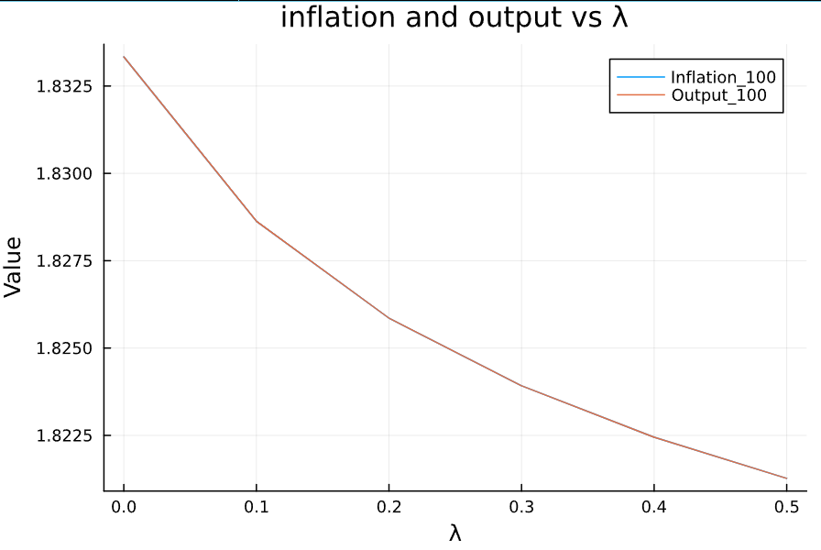
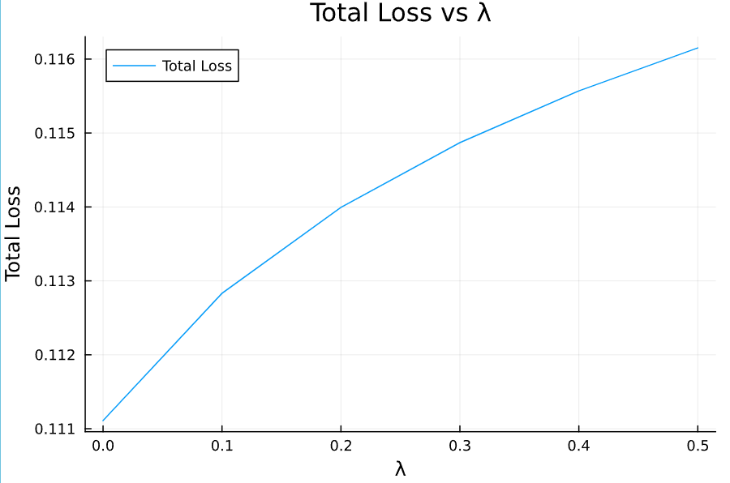
Dynamic game losses of leadership
If it was costless to adjust fiscal policy
The increase in instrument stickiness leads to lower equilibrium output and inflation.
The “total loss” between the two authorities also rises relative to the Nash Equilibrium outcome.
Notes:
Across the economy as a whole these higher adjustment costs reduce both output and inflation, and lead to larger overall losses.
This is a symmetric game – if fiscal policy was to introduce processes that made it difficult for them to react, while the monetary authority responded quickly during a crisis, this would lead to a similar situation where fiscal authorities would respond relatively less given a shock.

Slide 23
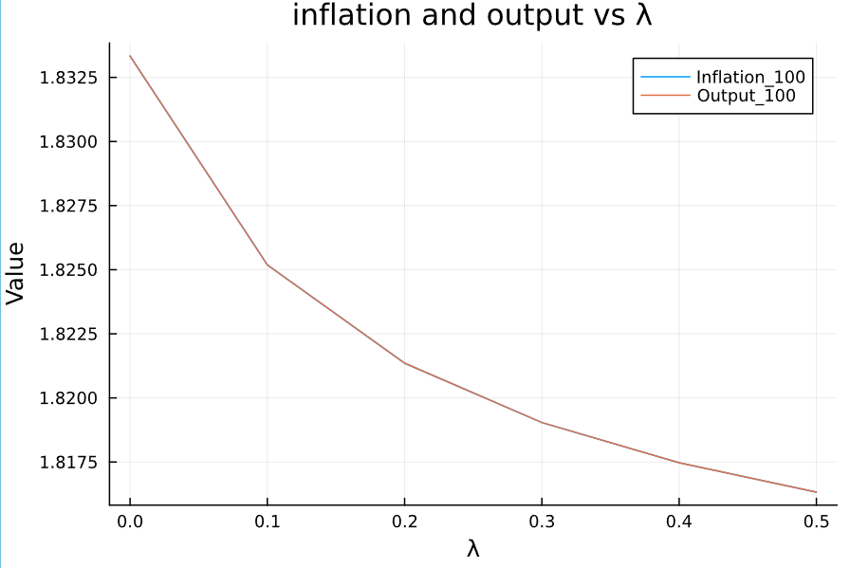
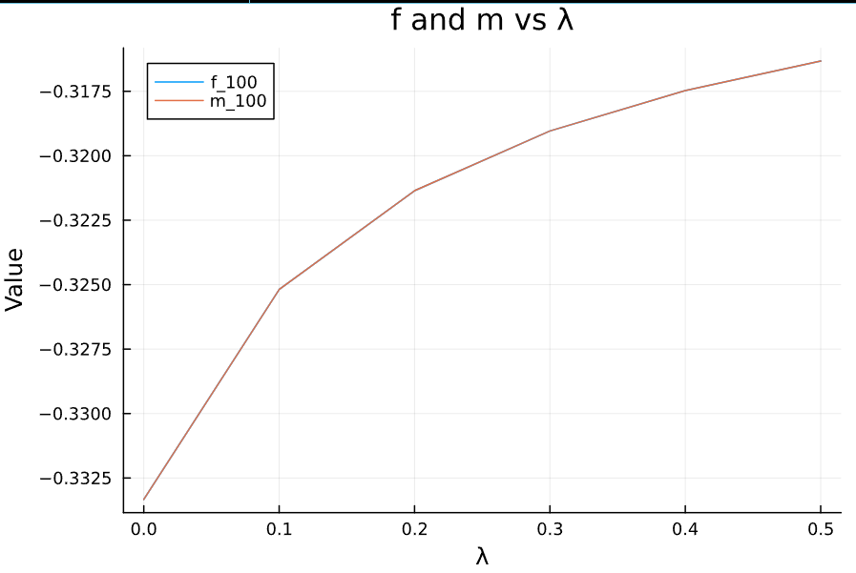
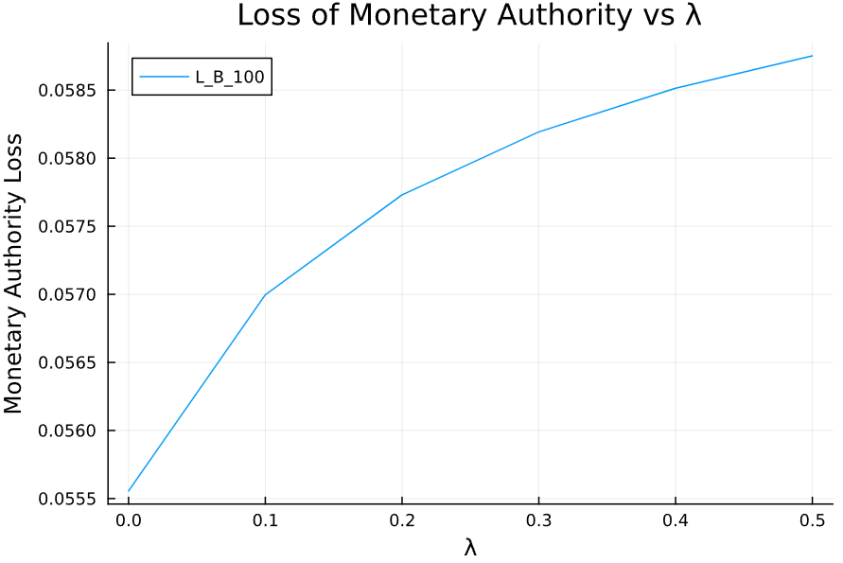
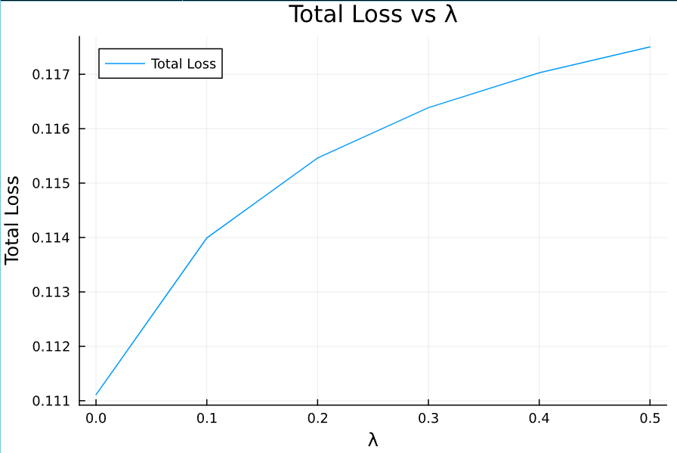
Dynamic equilibrium with varying adjustment costs
Same adjustment cost for fiscal and monetary policy
Notes:
Now when both monetary and fiscal authorities have adjustment costs – and they are the same cost (lambda) – we can see that these rising aggregate adjustment costs lead to less stimulus, lower output and inflation, and greater losses.
As a result, even though both authorities face an individual incentive to make it more costly to adjust instruments, this generates a prisoners dilemma when faced with a demand shock that makes both players worse off.
The key lesson here is that, if there is a conservative bias in monetary and fiscal policy (or an economic driver that makes sustained changes in policy costly), having a situation where authorities have precommited to actions (or have made it costly to change their actions) can lead to much larger declines in output and inflation than those that were necessary.
Instead of experiencing a loss of 0.1 in the cooperative game, or 0.111 in the NE, we end up with a loss of 0.1175 in the case where adjustment costs are 0.5 – even though the private incentives of both players are to select the game with those adjustment costs.
Examples of conservative bias: negative int rates, bond purchases level

Slide 24
Supply shocks and the benefits of commitment

Slide 25
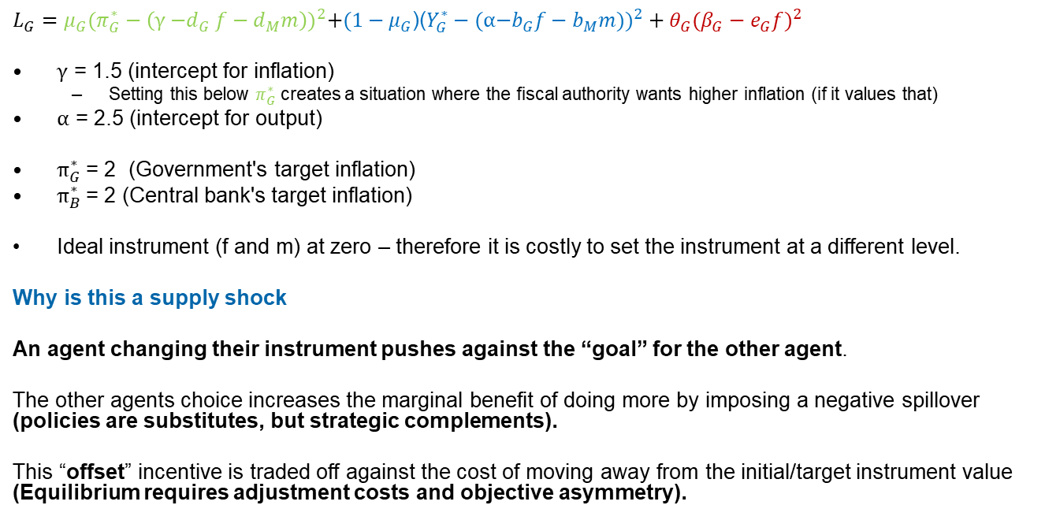
Static Supply shock (positive)
$L_{G}=μ_{G}{(π_{G}^{∗}−\left(\text{γ}{\text{−}d}_{G}f−d_{M}m\right))}^{2}+(1−μ_{G}$)(${Y_{G}^{∗}−(\text{α}\text{−}b_{G}f−b_{M}m))}^{2}+θ_{G}({β_{G}−e_{G}f)}^{2}$
$\text{γ}$ = 1.5 (intercept for inflation)
Setting this below $π_{G}^{∗}$ creates a situation where the fiscal authority wants higher inflation (if it values that)
$\text{α}$ = 2.5 (intercept for output)
$π_{G}^{∗}$= 2 (Government's target inflation)
$π_{B}^{∗}$= 2 (Central bank's target inflation)
Ideal instrument (f and m) at zero – therefore it is costly to set the instrument at a different level.
Why is this a supply shock
An agent changing their instrument pushes against the “goal” for the other agent.
The other agents choice increases the marginal benefit of doing more by imposing a negative spillover (policies are substitutes, but strategic complements).
This “offset” incentive is traded off against the cost of moving away from the initial/target instrument value (Equilibrium requires adjustment costs and objective asymmetry).
Notes:
In our supply shock game gamma and alpha move in opposite directions – specifically the shock reduces current inflation and increases current output. In this circumstance the fiscal authority will want to tighten while the monetary authority will want to loosen – leading to a game of monetary policy offset.
In the absence of adjustment costs there is no equilibrium to this game – as both players will try to fully offset each other for as long as they can. As a result, their actions are substitutes – someone making their optimizing choice will be imposing a cost on the other player. However, this is also a game of strategic complements as the players choice to act increases the marginal benefit of acting for the other player.
As a result, this type of game helps us to think about situations where the two players are offsetting each other – such as in the post-COVID economy.
*********************************************************************************
In this game “full offset” between monetary and fiscal authorities would lead to both instruments going in opposite directions to infinity, unless there is a constraint on their actions. This is the purpose of the “adjustment cost from target” in this loss function. In a macro-model equilibrium could be generated by relative economic responses to the instruments.

Slide 26
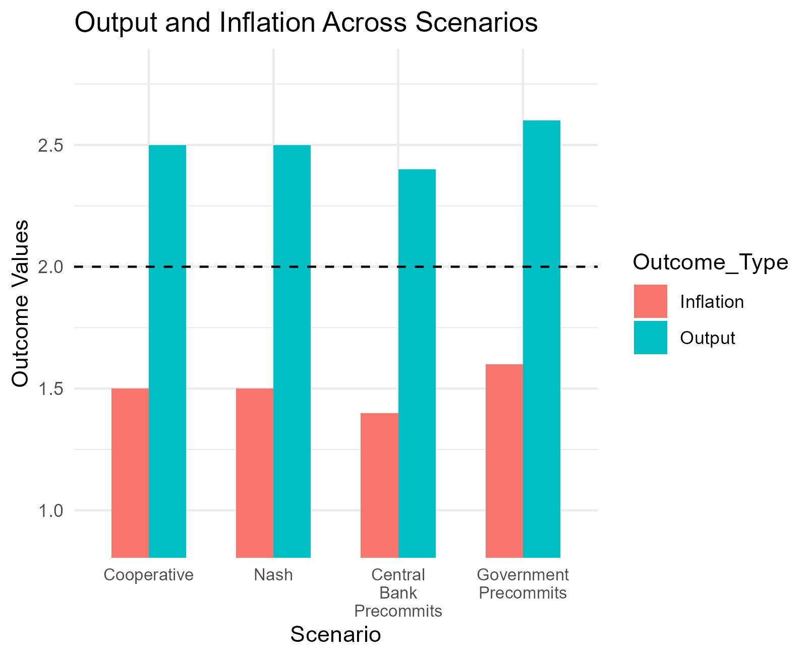
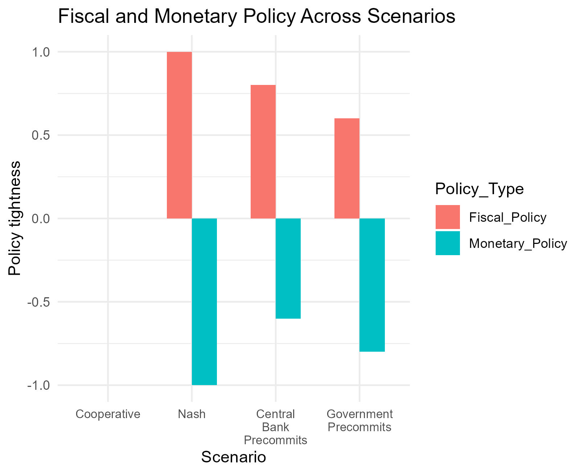
Choices (supply)
Notes:
Supply shock leads to:
Similar economic outcomes in NE and cooperative!
However, drastic change in relative policy settings in NE – if policy variability has a cost to social welfare then this is costly.
Pre-commitment/leadership generates a “second-mover advantage”. If the central bank pre-commits we end up with the lowest inflation outcomes, as the second mover determines which target we move closest to.
The key takeaway here is that coordinated actions would not respond – but the non-cooperative nature of the game leads both authorities to wastefully offset each other. In the current circumstance this may reflect the government spending more than it should while the central bank has to lift interest rates by more.
Stackelberg leadership reduces this instrument variability – with the first mover committing to do much less in order to reduce what the second mover does to some degree.

Slide 27
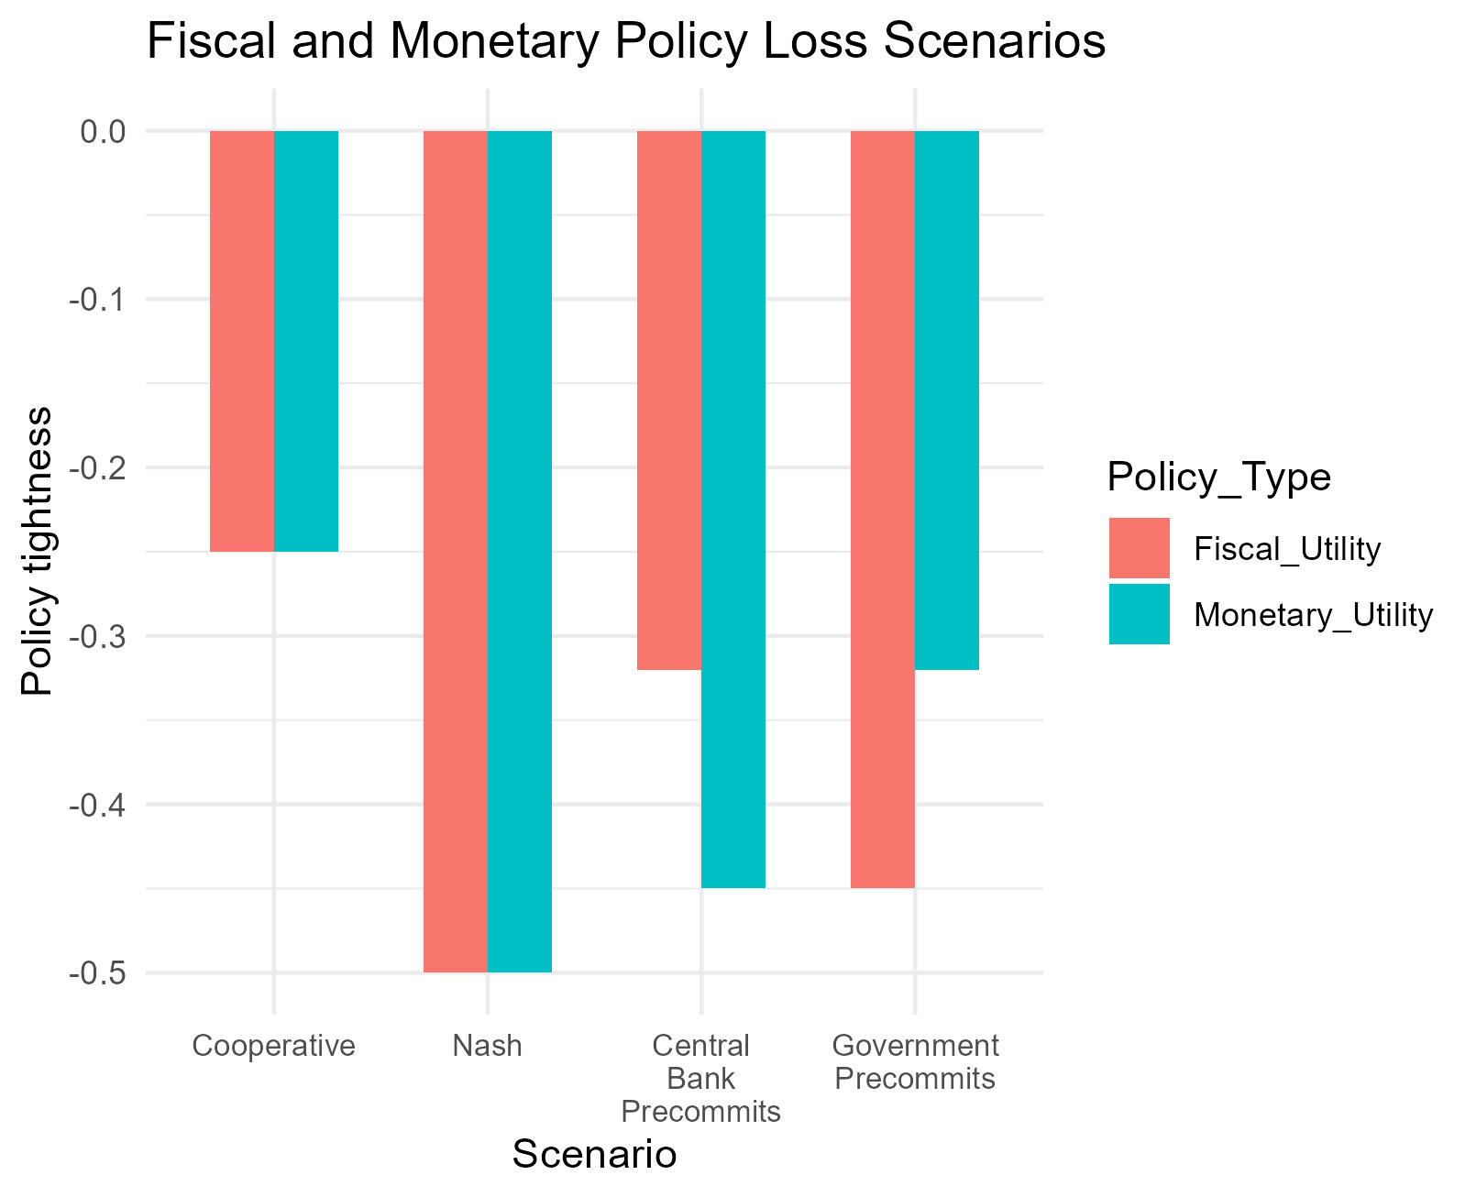
Payoffs (supply)
Notes:
The pre-commitment game reduces the “loss” to authorities through the cost of adjustment. As a result, precommitment improves outcomes when faced with such a shock
However, if social welfare does not care about adjustment costs (look at cooperative), then the pre-commitment outcomes are the worst among all – as the “non-adjustment cost” losses are slightly higher. As we will show, this result only holds when there is a single leader – when both players try to lead it is strictly better than the NE.

Slide 28
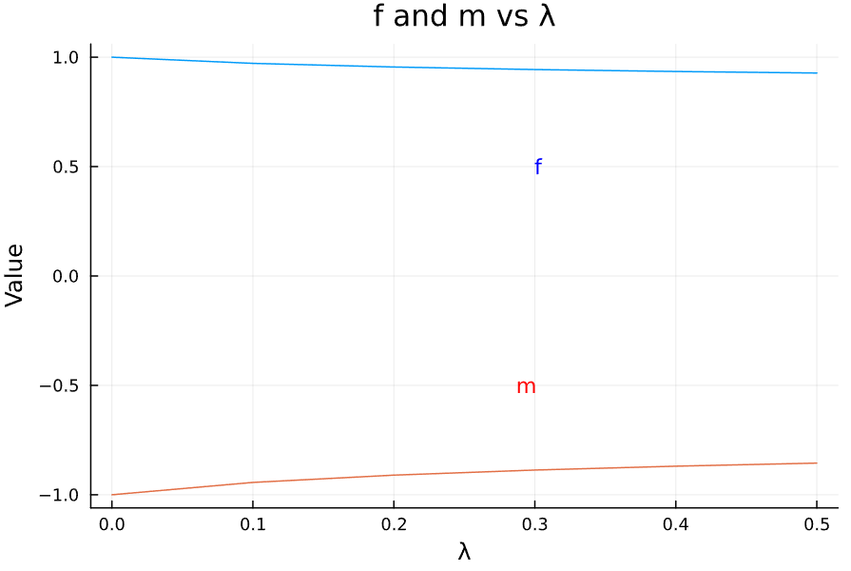
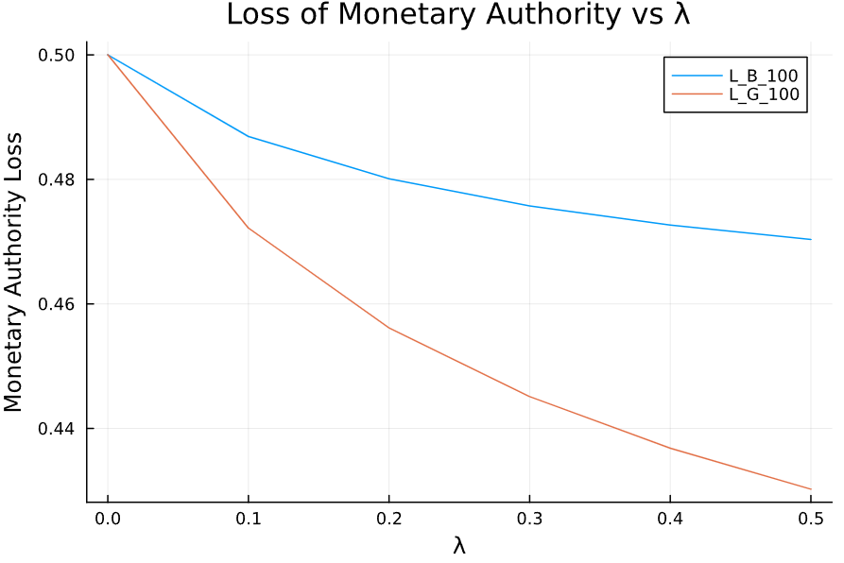
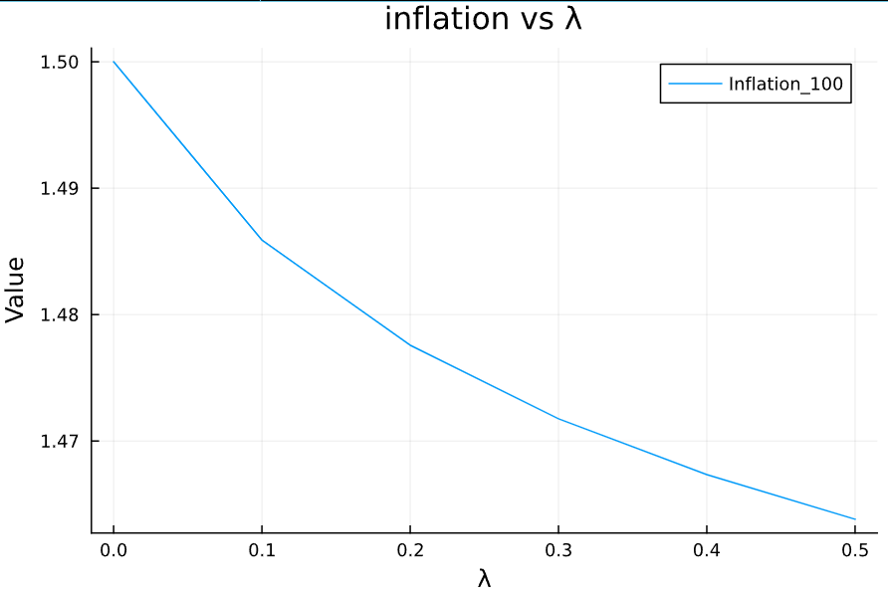
Leadership by one decision maker reduces offset
If it was costless to adjust fiscal policy
Here monetary authority is committing to “offsetting” by less due to costs of adjustment.
Second mover advantage.
Notes:
In the supply shock game, with no adjustment costs for fiscal policy, we can see that – as adjustment costs rise – monetary authorities ease by less and fiscal authorities tighten by less. Furthermore, the cost for the monetary authority declines – suggesting that they would be willing to impose such adjustment costs on themselves. However, there are two surprising outcomes.
The loss decline for the fiscal authority is much larger.
Inflation falls.
Ultimately there is a “second-mover advantage” in this game. Monetary authorities can benefit by reducing their stimulus, but fiscal policy will determine what happens with ultimate economic outcomes and they end up reducing their choice by less.

Slide 29
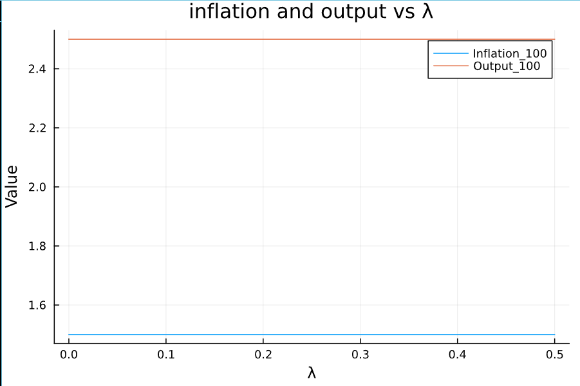
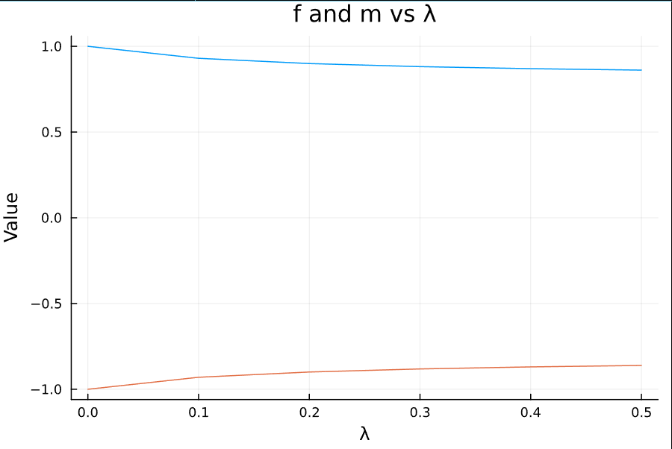
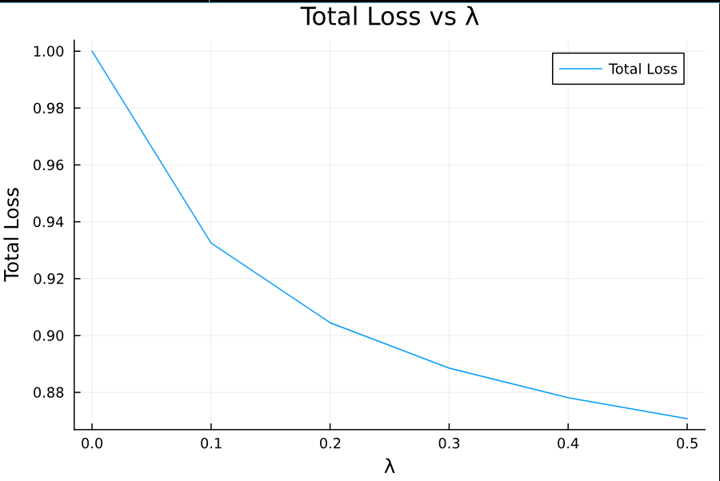
Both trying to lead
Adjustment costs push us towards the cooperative outcome
Notes:
When adjustment costs rise for both players, inflation and output are essentially unchanged but the loss and size of the policy response declines.
In the post-COVID economy this would suggest that – if adjustment costs for both monetary and fiscal policy changes had been higher, this would have led to smaller responses by both.

Slide 30
Next steps
Complete dynamic model and simulate for varying shocks.
Endogenise the choice of adjustment costs.
Incorporate into a macro-model to more formally model the economy. Use this to describe conflict in optimal policy rules, and how this varies based on the nature of shocks.
A separate piece of work trying to understand how broadening policy rules may work – use a HANK model to include a target for income/wealth inequality in the loss function.
Notes:
And that wraps up the coffee discuss today, thanks for coming along and all of the questions.
Our intended next steps are outlined on the slides, and now I’ll open up the floor for further questions and comments.

